Slide 1
Vue

Slide 2
Vue – Day 3

Slide 3
Agenda
Props
Directives
v-bind
v-html
v-for ( List Rendering )
v-model (Two way data binding )

Slide 4
Props
Props are custom attributes that can be passed into the component from its parent component.
Here are a few key points to understand about props in Vue.js:
Props are used to pass data from a parent component to a child component.
Props are defined in the parent component and then passed down to the child component as attributes.
The child component can use the props in its template or script to customize its behavior or appearance.
Props are reactive, which means that if the value of a prop changes in the parent component, the child component will automatically update to reflect the new value.
Props are validated, which means that you can specify the type and other requirements for a prop to ensure that it is used correctly.

Slide 5
Props
Props are an important part of Vue.js because they allow you to create reusable and flexible components that can be easily customized to suit different use cases.
By passing data down through props, you can build complex user interfaces that are easy to maintain and extend.

Slide 6
defineProps
defineProps is a built-in macro in Vue.js that is used to define the props that a component accepts.
defineProps is used in the script section of a component to declare the props that the component expects to receive.
When defining props with defineProps, you can specify their name, type, default value, and other options.
Props defined with defineProps are reactive, which means that if the value of a prop changes in the parent component, the child component will automatically update to reflect the new value.

Slide 7
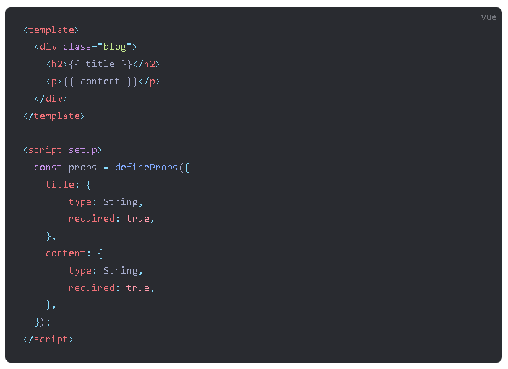
Props Example
This Vue.js component represents a blog post, with a title and content passed in as props.
The defineProps function defines the title and content props with their respective types and requirements.
The template renders the title and content props in HTML.

Slide 8
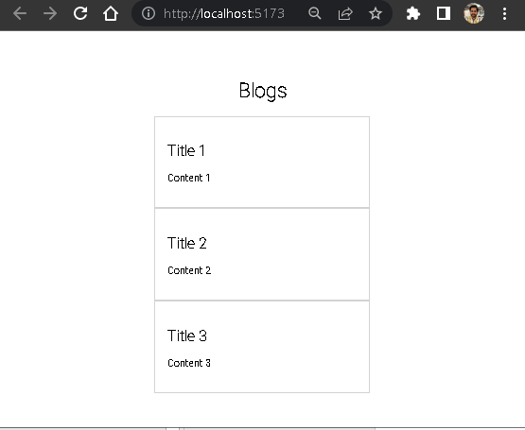
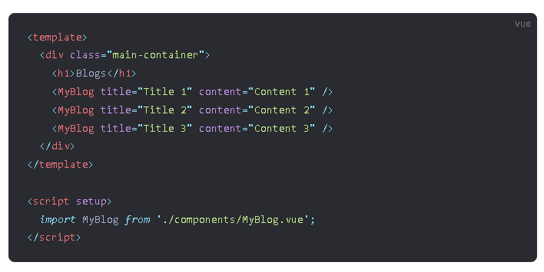

Importing MyBlog.vue in App.vue

Slide 9
Directives
Directives are special attributes in Vue that allow you to apply reactive behavior to elements in your templates.
Directives are denoted by the v- prefix in the attribute name.
Directives provide a concise and powerful way to create dynamic and reactive templates in Vue. By binding elements to data properties and expressions, directives allow you to create complex and interactive user interfaces with minimal code.

Slide 10
Directives
Here are some of the most commonly used directives in Vue:
v-bind: Bind an element's attribute or property to an expression or data property.
v-for: Render a list of items based on an array or object.
v-model: Create a two-way binding between a form input element and a data property.
v-html: Render the result of an expression as HTML content of an element.
v-if: Conditionally render an element based on a truthy value.
v-show: Conditionally show or hide an element based on a truthy value.
v-on: Bind an event listener to an element, triggering a method or expression when the event occurs.

Slide 11
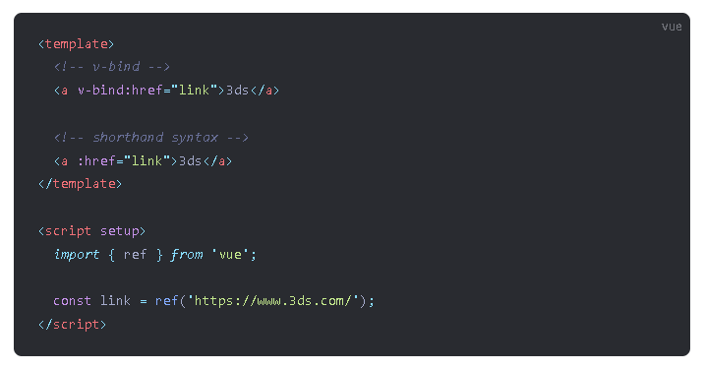
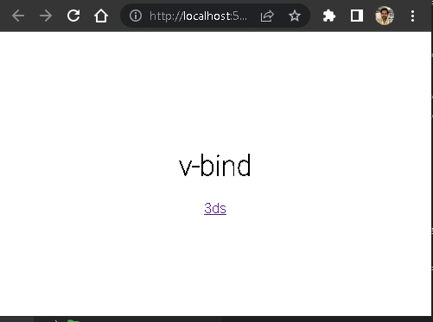
v-bind
v-bind is a Vue.js directive that allows us to bind a value or expression to a HTML attribute.

Slide 12
v-bind – Important Points
v-bind is used to bind an expression or value to an HTML attribute.
We can use shorthand syntax to bind a value directly to an attribute. For example, :href="url" is shorthand for v-bind:href="url".
We can also bind an expression to an attribute. For example, :class="{ active: isActive }" binds the class active to an element when isActive is true.
v-bind can be used to bind any attribute on an HTML element, not just the href or class attributes.
If the expression is a string, it will be evaluated as a JavaScript expression.
If the expression is an object, Vue.js will automatically convert it into a string and set the attribute.

Slide 13
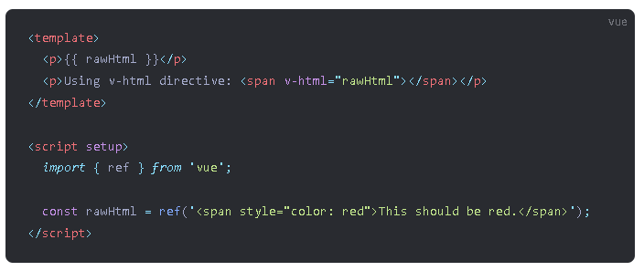
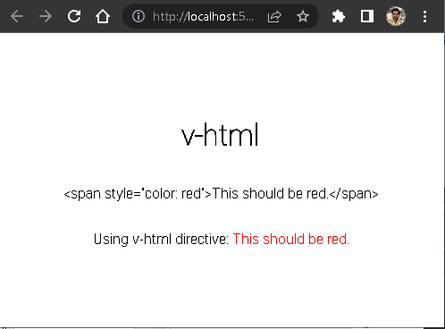
v-html
v-html is a Vue.js directive that allows us to render HTML content as a part of our template.

Slide 14
v-html – Important Points
v-html is used to bind an expression that returns HTML content to a element.
When using v-html, the contents of the expression are rendered as HTML, not as plain text.
We should only use v-html when the HTML content is trusted and comes from a safe source.
When the HTML content comes from a user or an external source, it should be sanitized to prevent cross-site scripting (XSS) attacks.
v-html should not be used with dynamic content that can be modified by users or other untrusted sources, as it can open the door to XSS attacks.

Slide 15
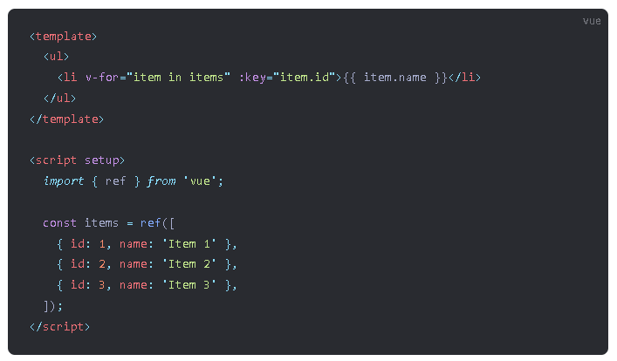
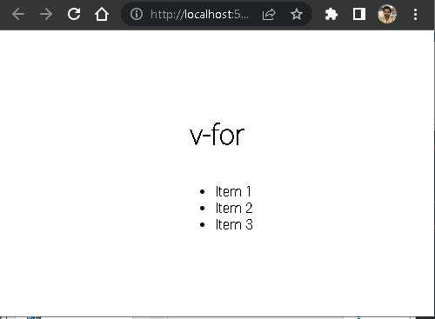
v-for ( List Rendering )
v-for is a Vue.js directive that allows us to render a list of items in our template.

Slide 16
v-for – Important Points
v-for is used to render a list of items in our template.
We use v-for to iterate over an array or an object.
We can use v-for on any element in the template, including the root element.
We use a special syntax to define the variable that represents each item in the list, as well as the name of the list we're iterating over. The syntax is v-for="(item, index) in list". item represents the current item in the list, while index represents the index of the current item. list is the name of the array or object we're iterating over.

Slide 17
v-for – Important Points
We can also use v-for to iterate over a range of numbers using the syntax v-for="n in count", where n represents the current number in the range and count is the number of items in the range.
We can use the v-bind:key directive to give each item in the list a unique identifier. This helps Vue.js track which items have been added, removed, or moved, and update the DOM accordingly.

Slide 18
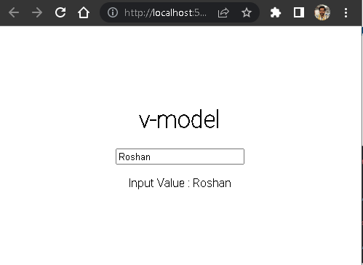
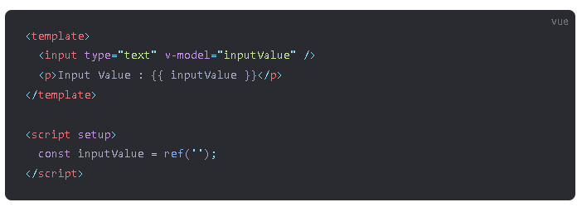
v-model ( Two way data binding )
v-model is a two-way binding directive in Vue.js, which allows us to bind form input values or components to a property in the Vue instance.

Slide 19
v-model – Important Points
v-model is a directive that creates a two-way binding between an input element and a property in the Vue instance.
The v-model directive can be used with various form input elements such as input, select, and textarea.
When a user interacts with the form input element, the value is automatically synced with the Vue instance property specified in v-model, and when the Vue instance property changes, the form input element is automatically updated.

